Slide 1
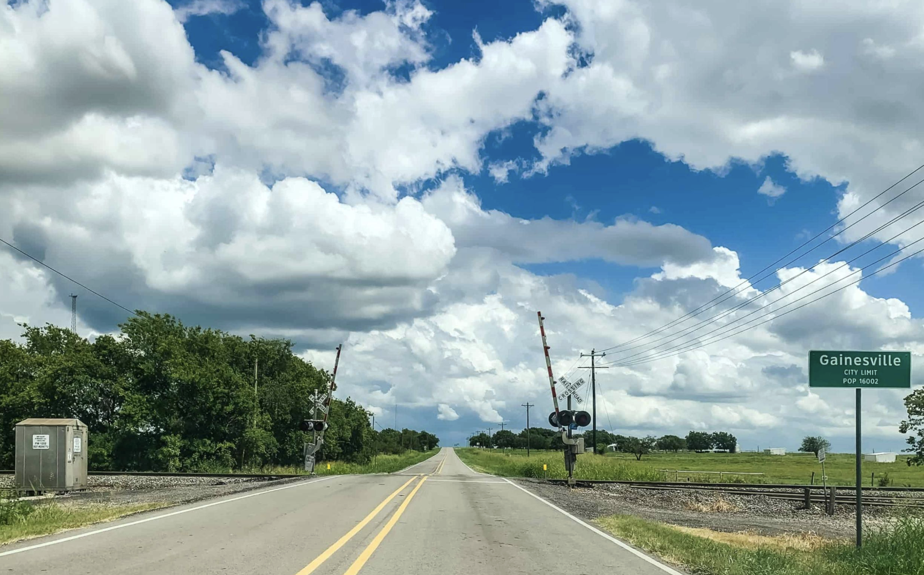

Gainesville
The Front Door of Texas Rail
Positioning North Texas for Rail Expansion

Slide 2
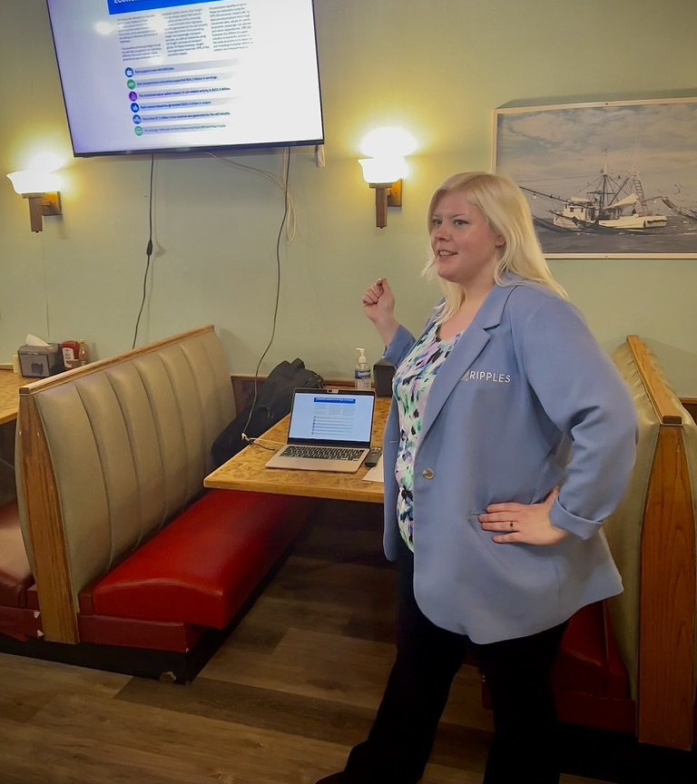
From Advocate to Actionist
• City-Designated Train Liaison
• CRO, Ripples GVL
• Advocate for Passenger Rail Expansion
“Not waiting for rail expansion—
organizing for it.”

Slide 3
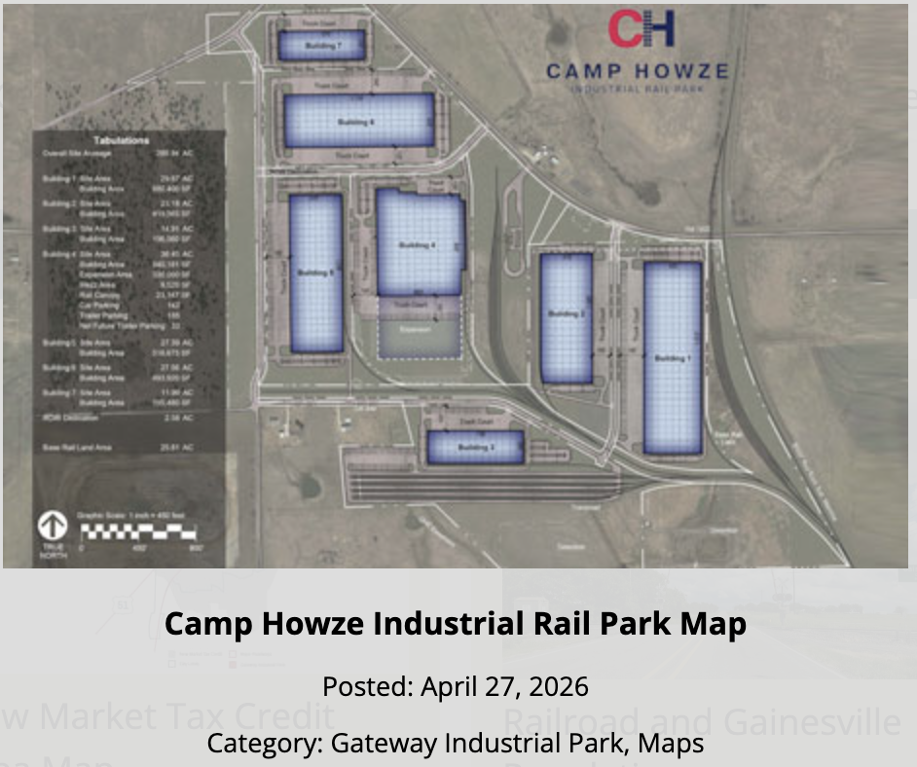
Infrastructure That Signals Intent
• Rail-connected development capacity
Flexible Tenancy options
10 Gigabit Fiber Optic
• Scalable Growth Opportunities
• Rail Spur access
https://www.gainesvilletxedc.com/featured-developments/camp-howze-industrial-rail-park/

Slide 4
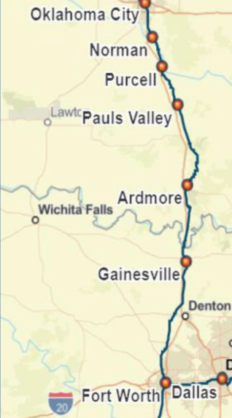

Why Gainesville Matters
• Positioned on I-35 Corridor
• Existing rail infrastructure
• Gateway between DFW & OKC

Slide 5
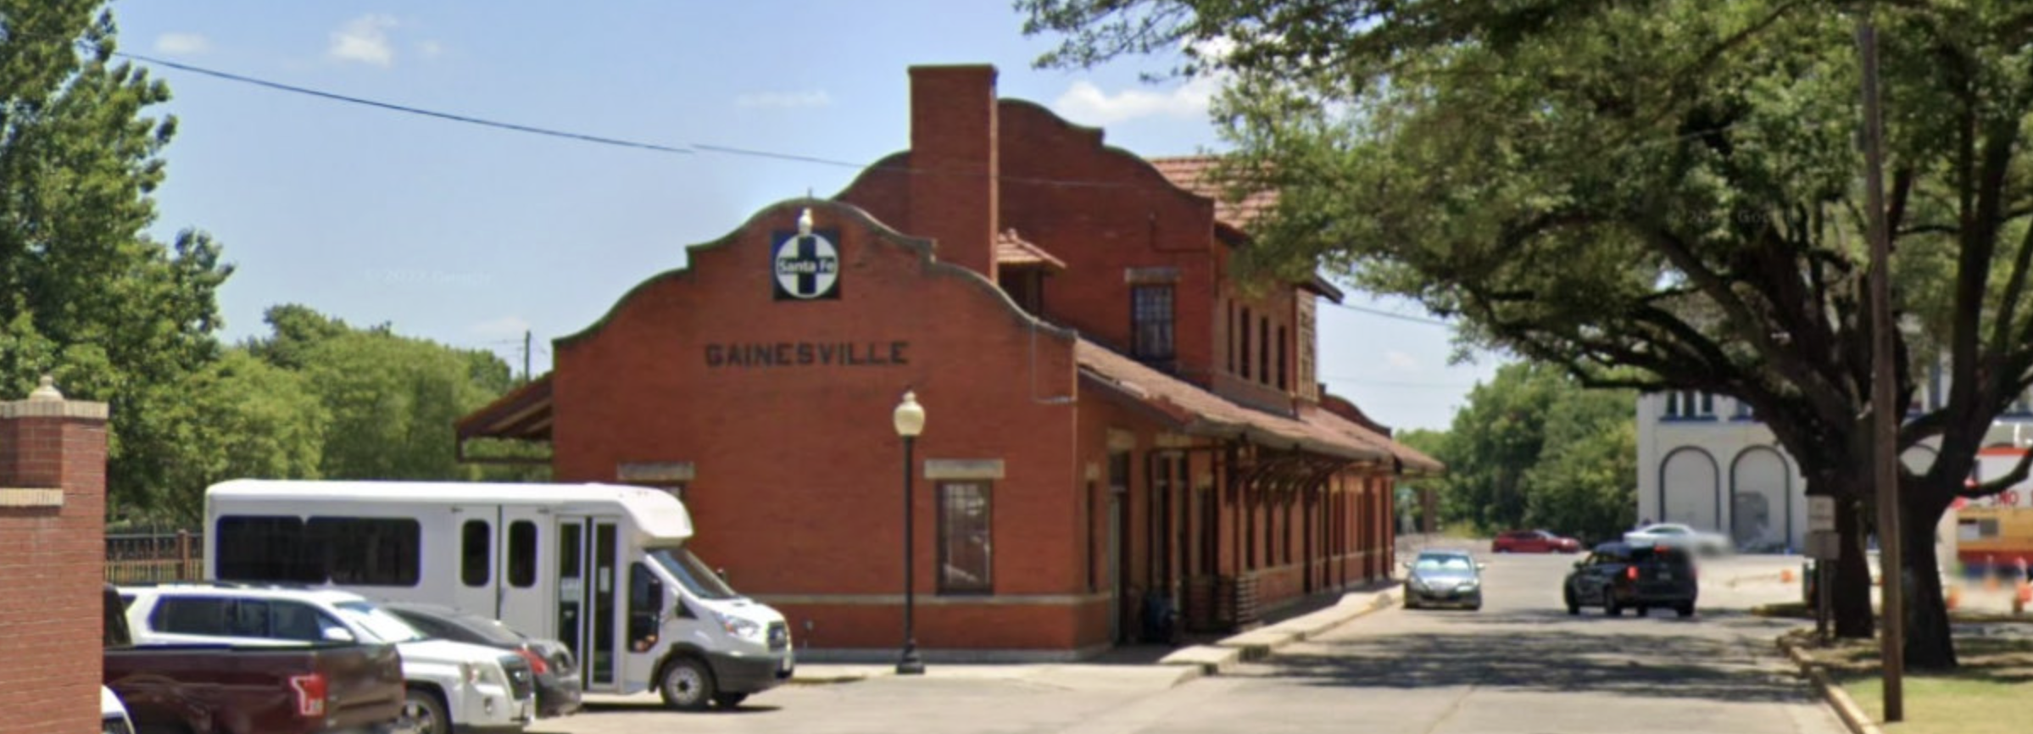
A Multi-Modal Future
• Transportation connectivity
• Economic revitalization
• Destination identity
• Regional access

Slide 6
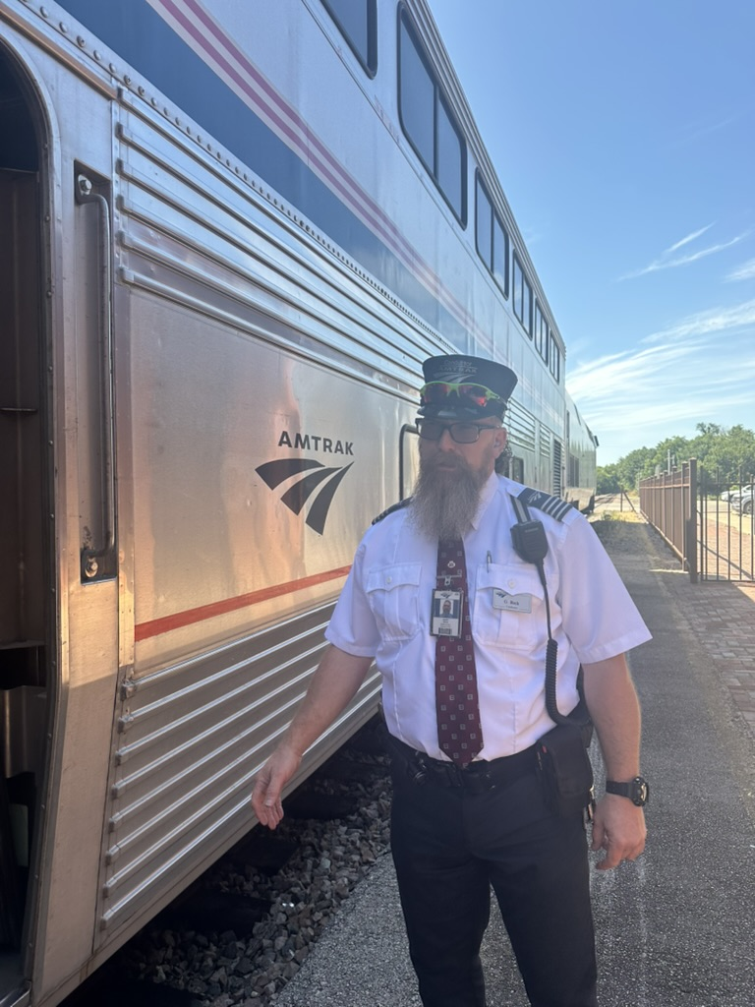
The Flyer Shouldn’t End Where
Opportunity Begins
• 80,000+ annual riders
• Vital regional connector
• Foundation for expansion

Slide 7
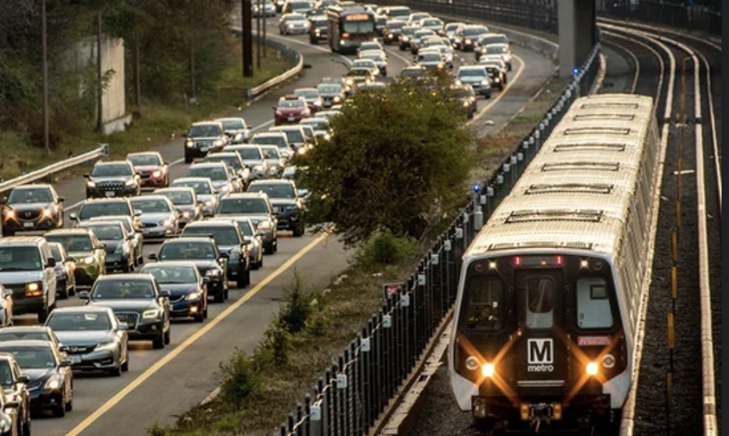
Texas Is Growing Faster Than Its
Mobility Systems
• I-35 congestion increasing
• Rail funding instability
• Regional coordination gaps

Slide 8
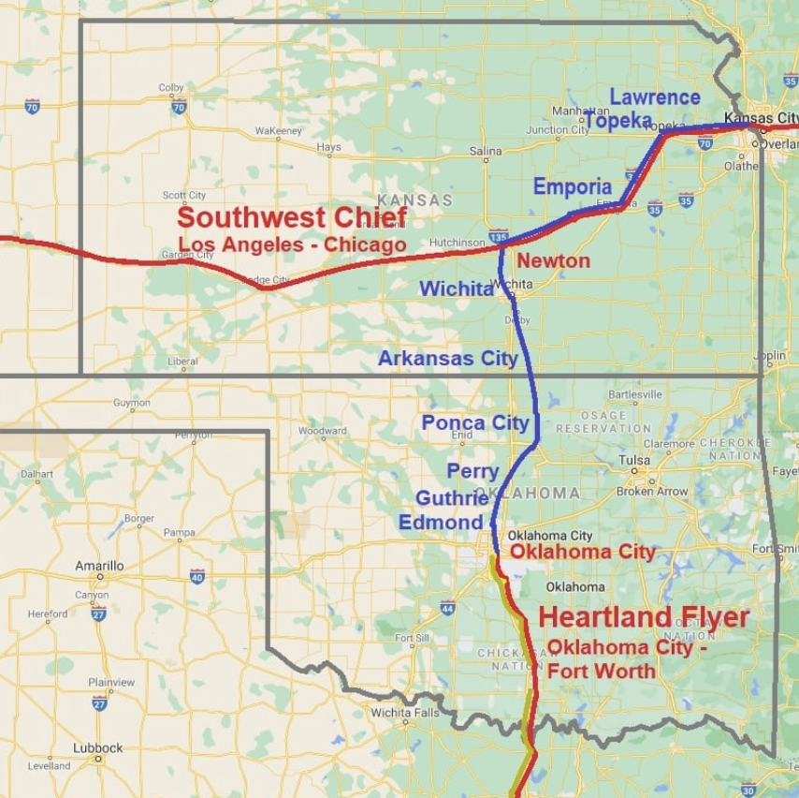
Why Gainesville? Why Now?
• Expansion-ready infrastructure
• Strategic location
• Community momentum
• Speed to implementation

Slide 9
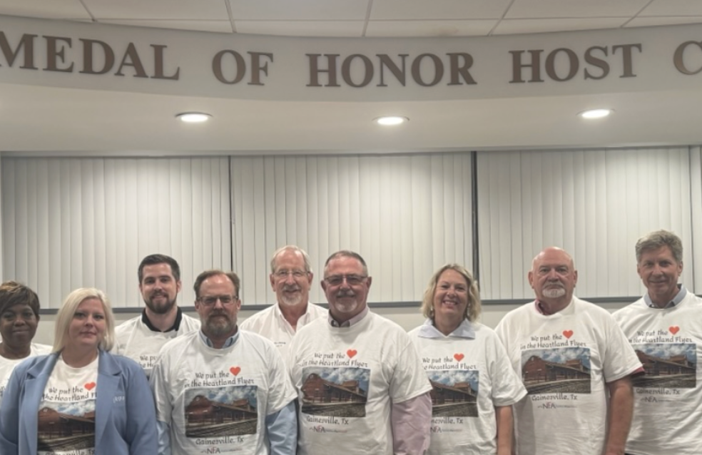
Stronger Through Alignment
• Business Organizations
• Civic leadership
• Regional collaboration
​

Slide 10

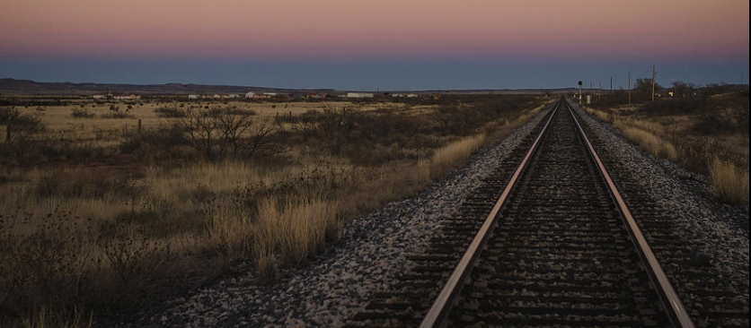
Start a Ripple
1. Search the Letter of Support
2. Sign
3. Share with 3 people
“Momentum starts with signal.”

Slide 11
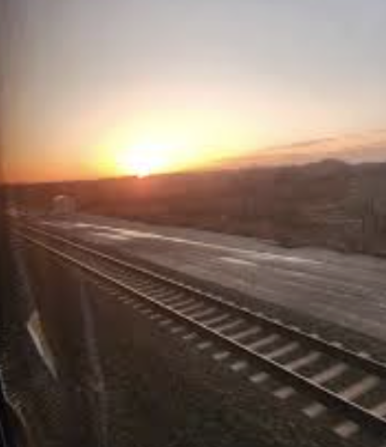
Let’s Build the Front Door Together
Gainesville is ready.
Contact:
Tavia Evans
(903)357-1724
Tavia@rippletogether.org

